Slide 1
STOR 455 Class 2
Read: Chapter 0
Exercises: All Chapter 0 exercises
Homework 0 due Monday at 5pm

Slide 2
Example: Distance to Home
Question:
How can we predict the distance from campus to home for Carolina students?
Data: Estimated distance to home (in miles) for students taking STOR 455 in a previous semester.
Predictor variables: Start with none.

Slide 3

Example: Constant Model
where c is an (unknown) constant
Terminology:
The constant c is a parameter of this model.
We use data to provide a sample estimate of c.
How should we estimate $c$ from data?

Slide 4




Predicted Value for Response
Get an estimate for Y using the predictors and the model with estimated parameters.
Notation: The predicted y is denoted $\hat{y}$
For the constant model: $\hat{y}=\hat{c}$
Examples:
$\hat{y}=\hat{c}=\overline{y}$ (sample mean)
$\hat{y}=\hat{c}=m$ (sample median)

Slide 5
A First RStudio Session
```{r}
# loads a package needed to use the read_csv() function
# install packages before first using it for the first time
library(readr)
library(mosaic)
# loads the DistanceHome dataframe into the environment from github
DistanceHome <- read_csv("https://raw.githubusercontent.com/JAMcLean/STOR455/master/data/DistanceHome.csv")
# Alternative way to load dataframe (remove # to use)
# DistanceHome.csv must be saved in the same folder as this notebook!
#DistanceHome <- read_csv("DistanceHome.csv")
# Shows the variables and first 6 cases (by default)
head(DistanceHome)
```

Slide 6
A First RStudio Session
Summarize the Distance variable - Numerical: mean and median
# dataframe$variable_name
mean(DistanceHome$Distance)
median(DistanceHome$Distance)
[1] 844.6234
[1] 113

Slide 7
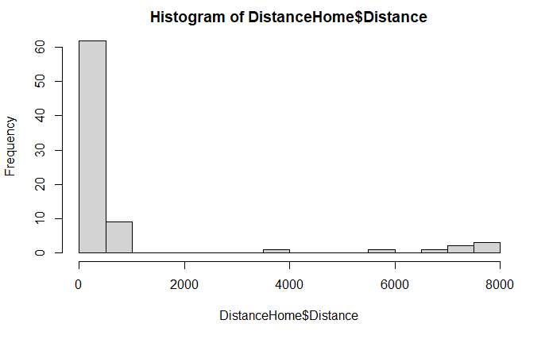
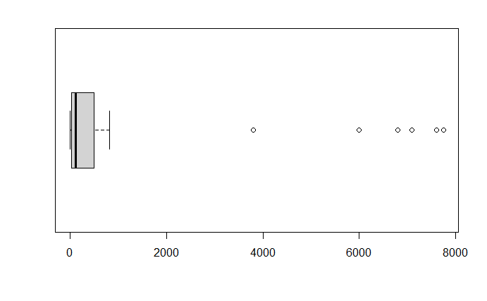
A First RStudio Session
Summarize the Distance variable - Graphical: histogram, boxplot
hist(DistanceHome$Distance)
boxplot(DistanceHome$Distance, horizontal = TRUE)

Slide 8
Can we use a predictor to improve the model?
X = Hours to travel home?
See Chapter 1
X = Introvert?
Two-sample t-test for a difference in means

Slide 9
Mosaic Package
install.packages("mosaic")
library(mosaic)
General use of “formulas”
Uses data= to minimize need for dataframe$variable
Example:
mean(Distance~Introvert, data=DistanceHome)
Response ~ explanatory
(formula)

Slide 10
Distance vs. Introversion
#These use the mosaic package
tally(~Introvert, data=DistanceHome)
Introvert
Extroversion Introversion
38 41
mean(Distance~Introvert, data=DistanceHome)
Extroversion Introversion
365.6026 1288.5939
sd(Distance~Introvert, data=DistanceHome)
Extroversion Introversion
1094.443 2559.412
boxplot(Distance~Introvert, data=DistanceHome, horizontal=TRUE)
Does Introversion appear to be helpful for predicting Distance?

Slide 11
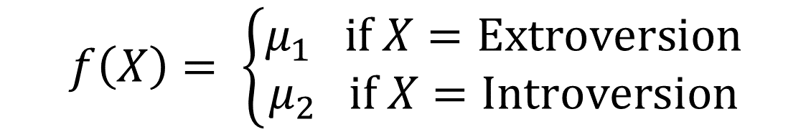
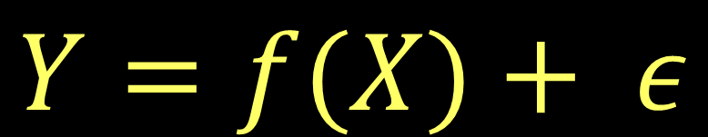
Model with a Binary Predictor
$$Y=f(X)+ ε$$
where X = Introversion
μ₁ = mean distance for Extroverts
μ₂ = mean distance for Introverts
$$f\left(X\right)= \left\{\begin{matrix}μ_{1} if X=Extroversion \\ μ_{2} if X=Introversion\end{matrix}\right.$$

Slide 12
Two-sample T-Test Difference in Means
H_{o}: μ₁ = μ₂
H_{a}: μ₁ ≠ μ₂
Compare to a
t-distribution
t.test(Distance~Introvert, data=DistanceHome)
Welch Two Sample t-test
data: Distance by Introvert
t = -2.1103, df = 55.025, p-value = 0.03939
alternative hypothesis: true difference in means is not equal to 0
95 percent confidence interval:
-1799.48957 -46.49298
sample estimates:
mean in group Extroversion mean in group Introversion
365.6026 1288.5939
What does this mean?

Slide 13
P-Value
The p-value is the proportion of samples, when the H₀ is true, that would be as (or more) extreme as the observed sample.
Decision: Reject H₀ only when the p-value is small.
For distance home the Introvert variable does improve the model significantly?

Slide 14
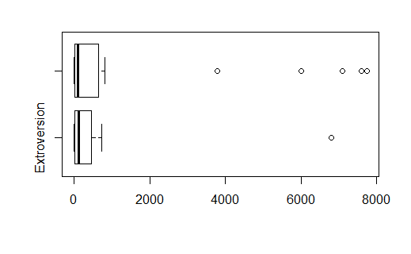
Normality?
The two-sample t-test assumes both samples are from normal populations
Does normality look reasonable?

Slide 15
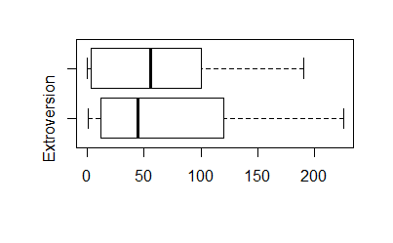
Domestic Distance
Suppose that we look only at distances that are really “drivable”?
Domestic=subset(DistanceHome,Distance<250)
head(Domestic)
boxplot(Distance~Introvert, data=Domestic, horizontal=TRUE)

Slide 16
Domestic Distance
Suppose that we look only at distances that are really “drivable”?
t.test(Distance~Introvert, data=Domestic)
data: Distance by Introvert
t = 0.09629, df = 51.968, p-value = 0.9237
alternative hypothesis: true difference in means is not equal to 0
95 percent confidence interval:
-33.17687 36.52132
sample estimates:
mean in group Extroversion mean in group Introversion
67.16667 65.49444
For distance home (only including students less than 250 miles from home) the Introvert variable does not improve the model significantly.

Slide 17
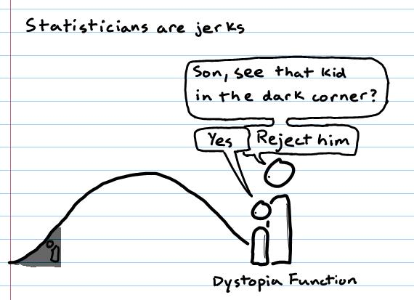
Review of Inferential Reasoning

Slide 18
To Get A Stat2 Dataset
All of the datasets for the Stat2 textbook are stored in an R package called Stat2Data.
You need to load the Stat2Data package
To load an existing dataset, just call it with data( ).
data(BaseballTimes)
To see what's in the dataframe, use View( ) to put in the viewer or head( ) to show the first few cases
head(BaseballTimes)

Slide 19
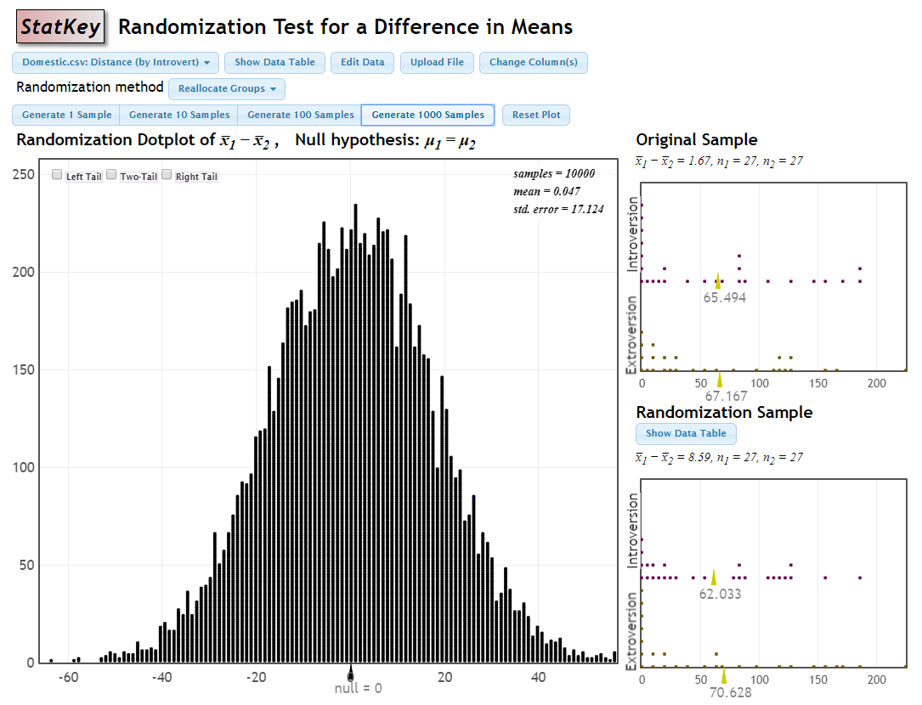
Inference Review: Hypothesis Testing
Suppose that we look only at distances that are really “drivable”?
Domestic=subset(DistanceHome,Distance<250)
H_{o}: μ_{I} = μ_{E}
H_{a}: μ_{I} ≠ μ_{E}

Slide 20
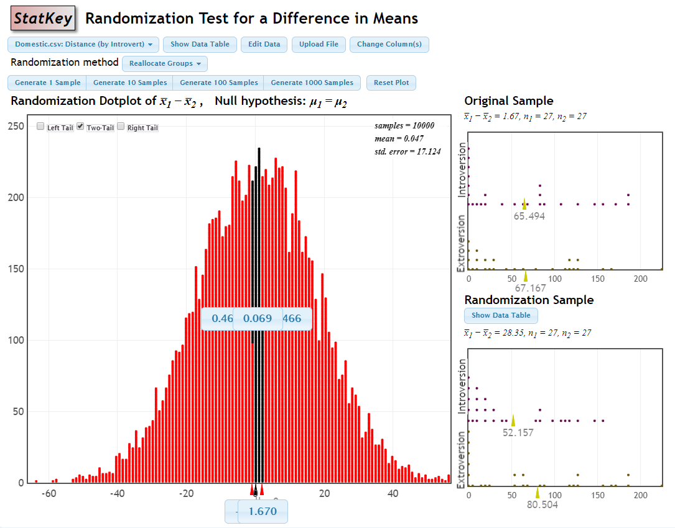
Inference Review: Hypothesis Testing
Suppose that we look only at distances that are really “drivable”?
Domestic=subset(DistanceHome,Distance<250)
There is a 93.3% chance that we would receive a samples with a difference as extreme as we did if the null hypothesis is true.
p-value = 0.933
H_{o}: μ_{I} = μ_{E}
H_{a}: μ_{I} ≠ μ_{E}

Slide 21
Inference Review: Hypothesis Testing
Suppose that we look only at distances that are really “drivable”?
Domestic=subset(DistanceHome,Distance<250)
Since the p-value is greater than 0.05, we fail to reject the null hypothesis.
There is not evidence to suggest that there is a difference in the number of miles from home Carolina students are (of those students 250 miles or less) based on if they are introverts or extroverts.
There is a 93.3% chance that we would receive a samples with a difference as extreme as we did if the null hypothesis is true.
p-value = 0.933
H_{o}: μ_{I} = μ_{E}
H_{a}: μ_{I} ≠ μ_{E}

Slide 22
Domestic Distance
Suppose that we look only at distances that are really “drivable”?
t.test(Distance~Introvert, data=Domestic)
data: Distance by Introvert
t = 0.09629, df = 51.968, p-value = 0.9237
alternative hypothesis: true difference in means is not equal to 0
95 percent confidence interval:
-33.17687 36.52132
sample estimates:
mean in group Extroversion mean in group Introversion
67.16667 65.49444
For distance home (only including students less than 250 miles from home) the Introvert variable does not improve the model significantly.

Slide 23
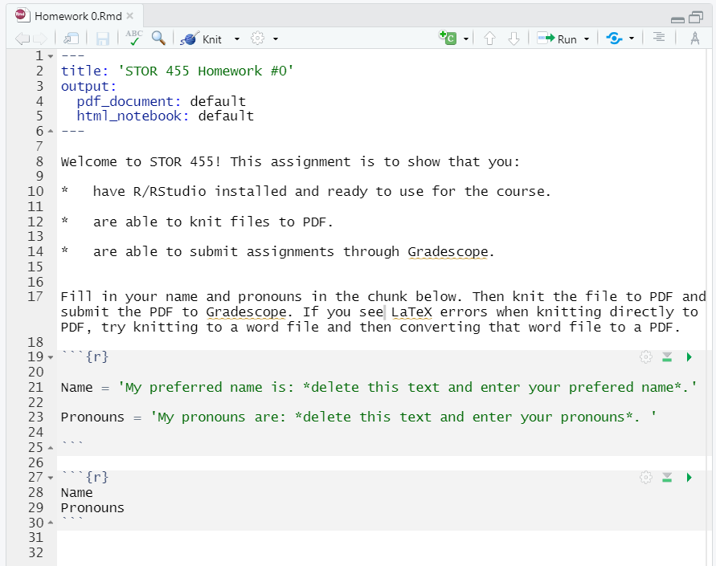
Homework 0

